Slide 1






Welcome!
dO yOu NeEd HeLp wiTh ThAt?
Anna, Dauren, aTHENA. Himangshu, m0ritz

Slide 2
Methadone Prices on the Black Market Across the United States
(just kidding)
IDS702 Team Project Group Yellow

Slide 3

Data & Modeling Process
Data Set: Methadone
Process
StreetRx: Crowdsourced data on diverted prescription drugs
Unreliable data inputs
Data Cleaning
EDA
StreetRx User
Linear Model Fitting
Hierarchical Model Fitting
Interpretations
Notes:
Moritz

Slide 4

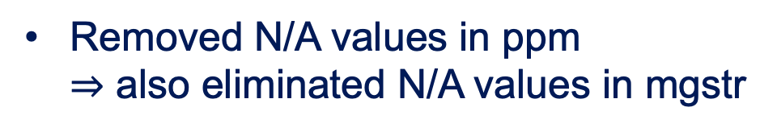

Data Cleaning
Consolidation of source
Missing Values
Removed N/A values in ppm
$⇒$ also eliminated N/A values in mgstr
Internet
http://...
Google
Pharmacy
StreetRx
Internet
Levels of mgstr
Heard it
Blanks
N/A
None
No Input
Personal
Removed uncommon mgstr & factorized it
to pay $40/mg for Methadone
Notes:
Moritz

Slide 5
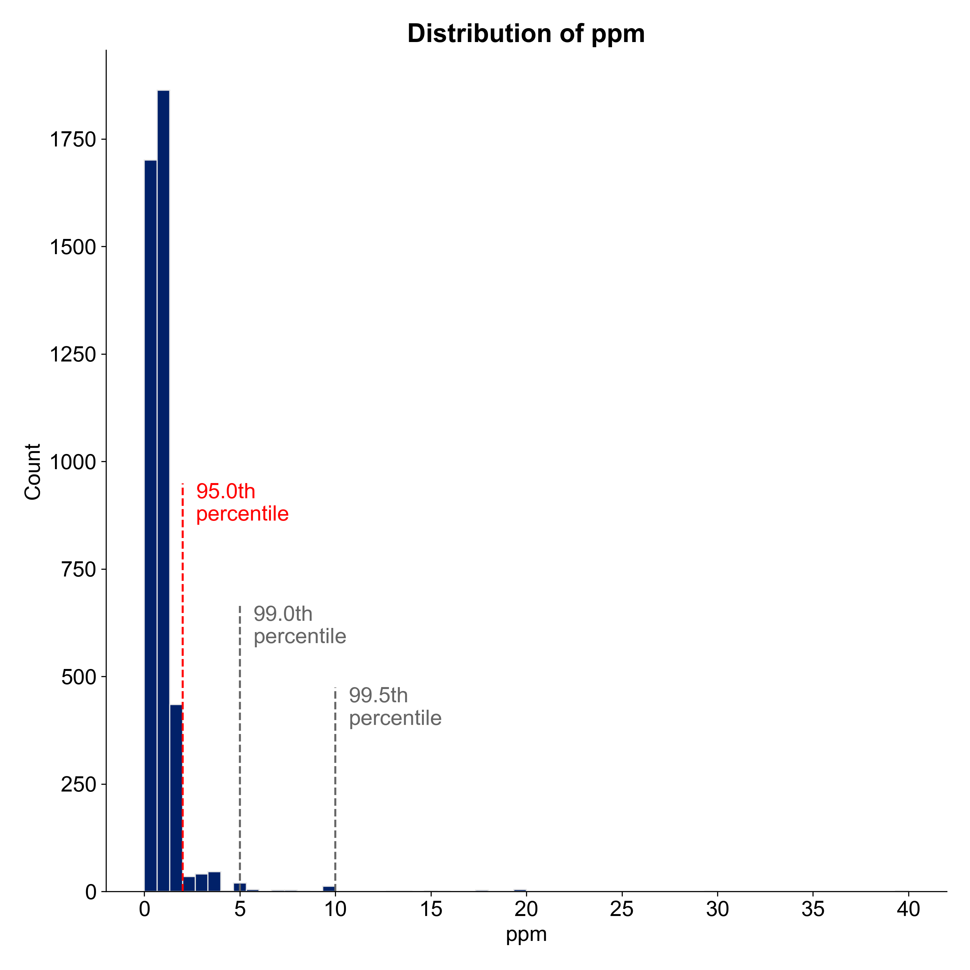
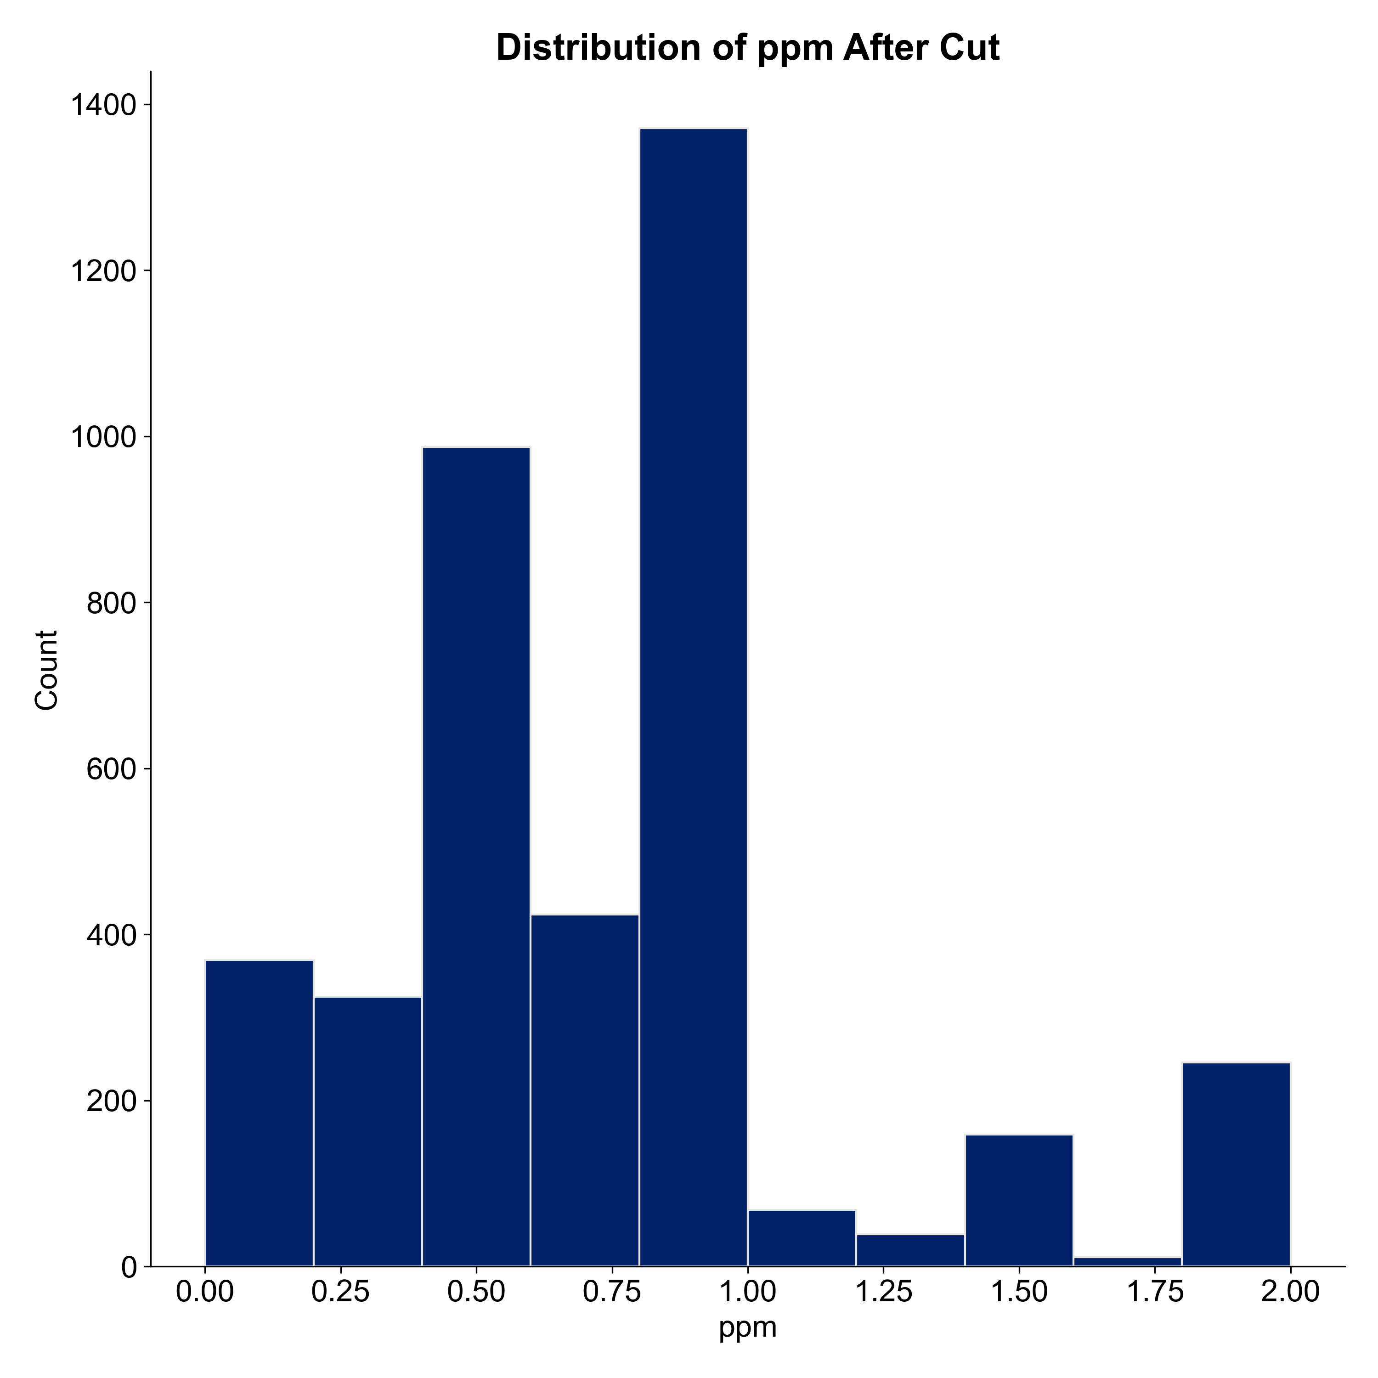
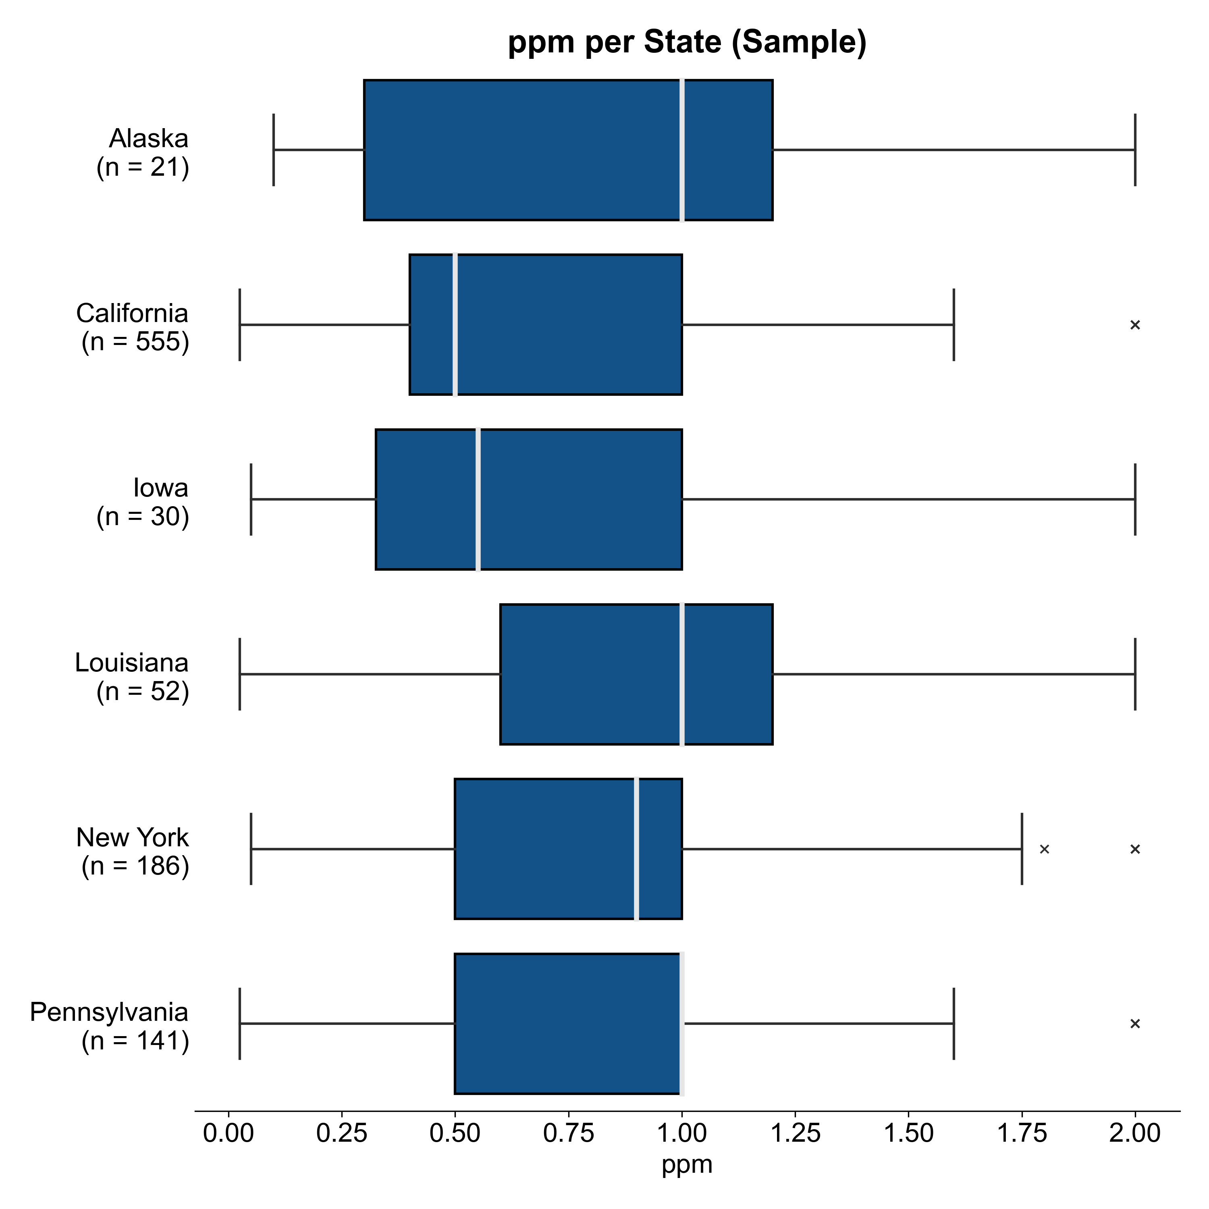
EDA
Distribution of Price per mg
Distribution by Location
Removed 181 outliers
> 95th percentile
(cutoff at $2/mg)
Notes:
Moritz

Slide 6
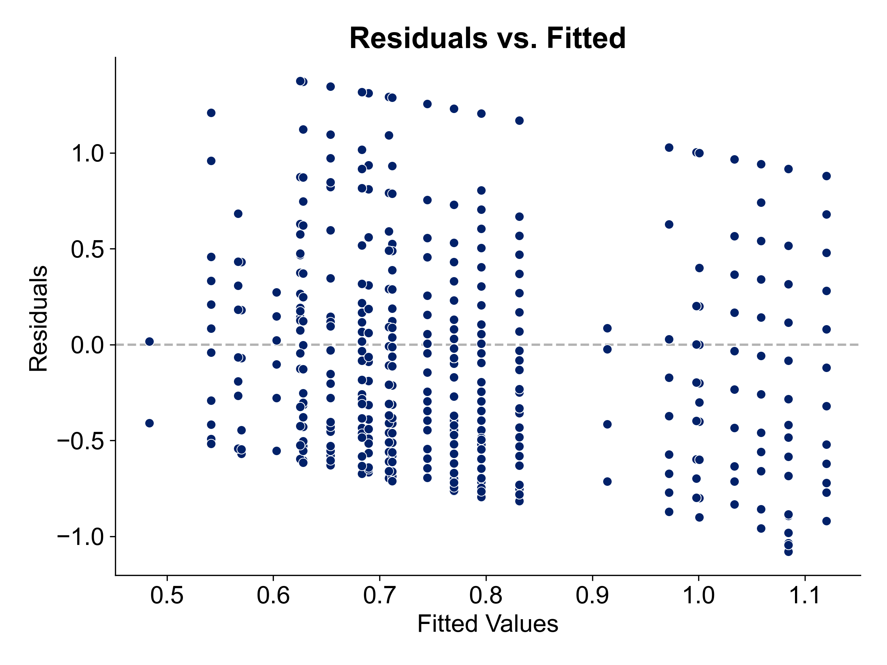
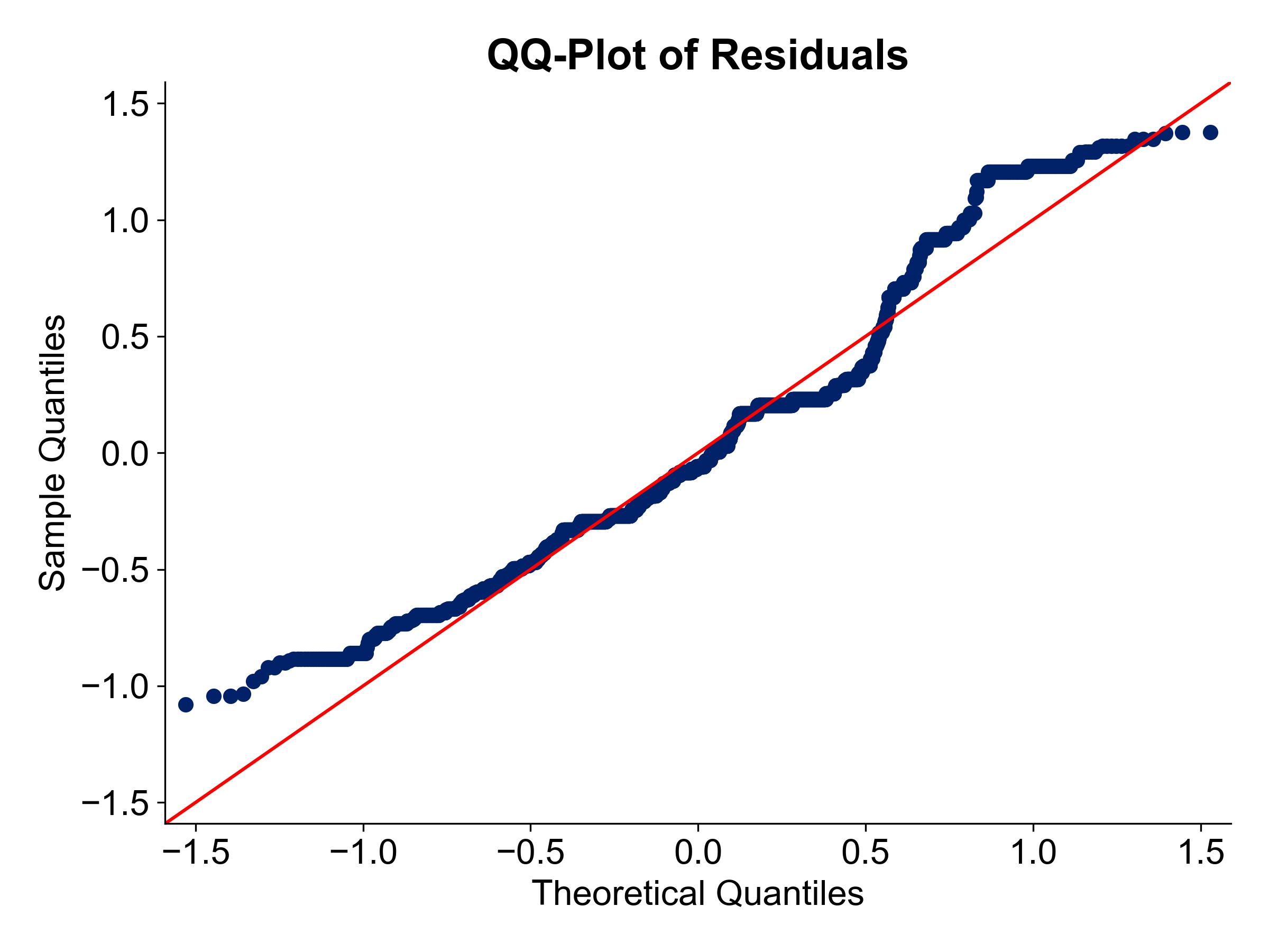
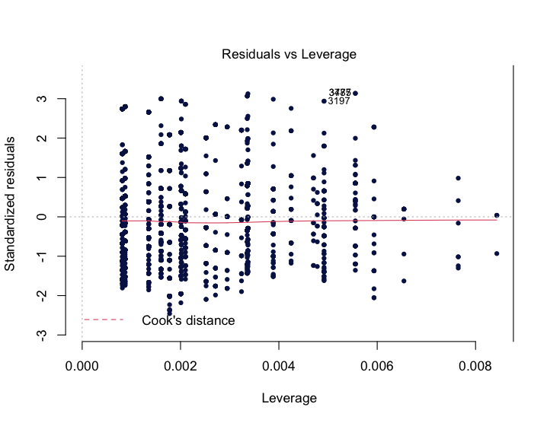
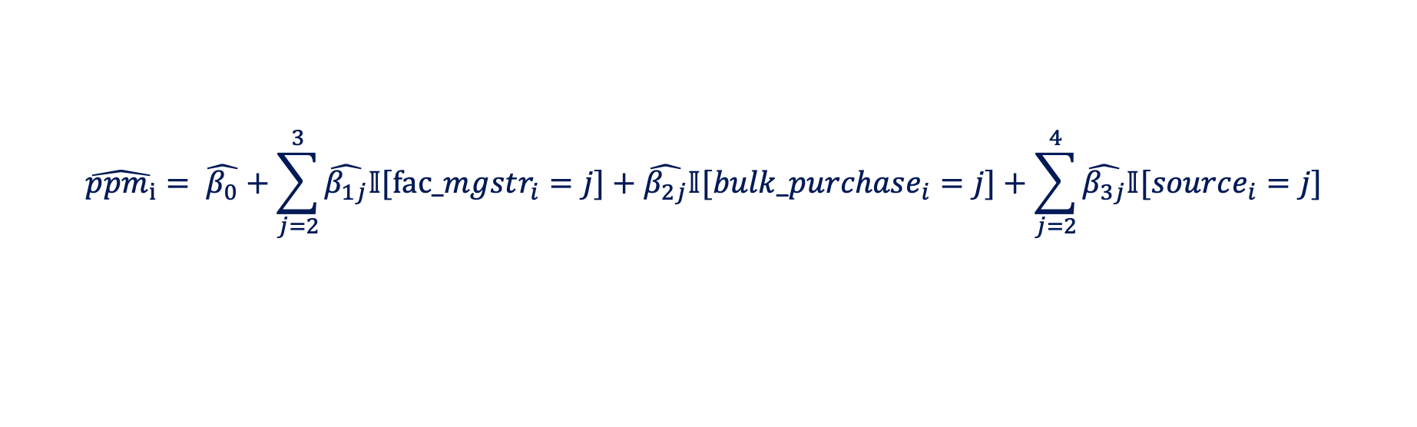
Linear Model Fitting
Null Model
Intercept only
Parameters
AIC
Direction = both
Full Model
All non-location predictors
Resulting Model
$$\hat{ppm_{i}}= \hat{β_{0}}+\sum_{j=2}^{3}{\hat{β_{1j}}𝕀[fac_mgstr_{i}=j]}+\hat{β_{2j}}𝕀[bulk_purchase_{i}=j]+\sum_{j=2}^{4}{\hat{β_{3j}}𝕀[source_{i}=j]}$$
Model Assessment
Residuals vs Leverage
Leverage
Notes:
Moritz

Slide 7


Hierarchical Model Fitting
Choice of Levels
Region-Only
AIC = 4783.70
State-Only
AIC = 4760.23
State & Region
AIC = 4756.86
$$>$$
$$>$$
State-Only vs. State & Region
*
* Difference from above due to ML vs. REML refitting
ppm ~ fac_mgstr + bulk_purchase + source + (1 | USA_region) + (1 | state)
Notes:
Moritz

Slide 8
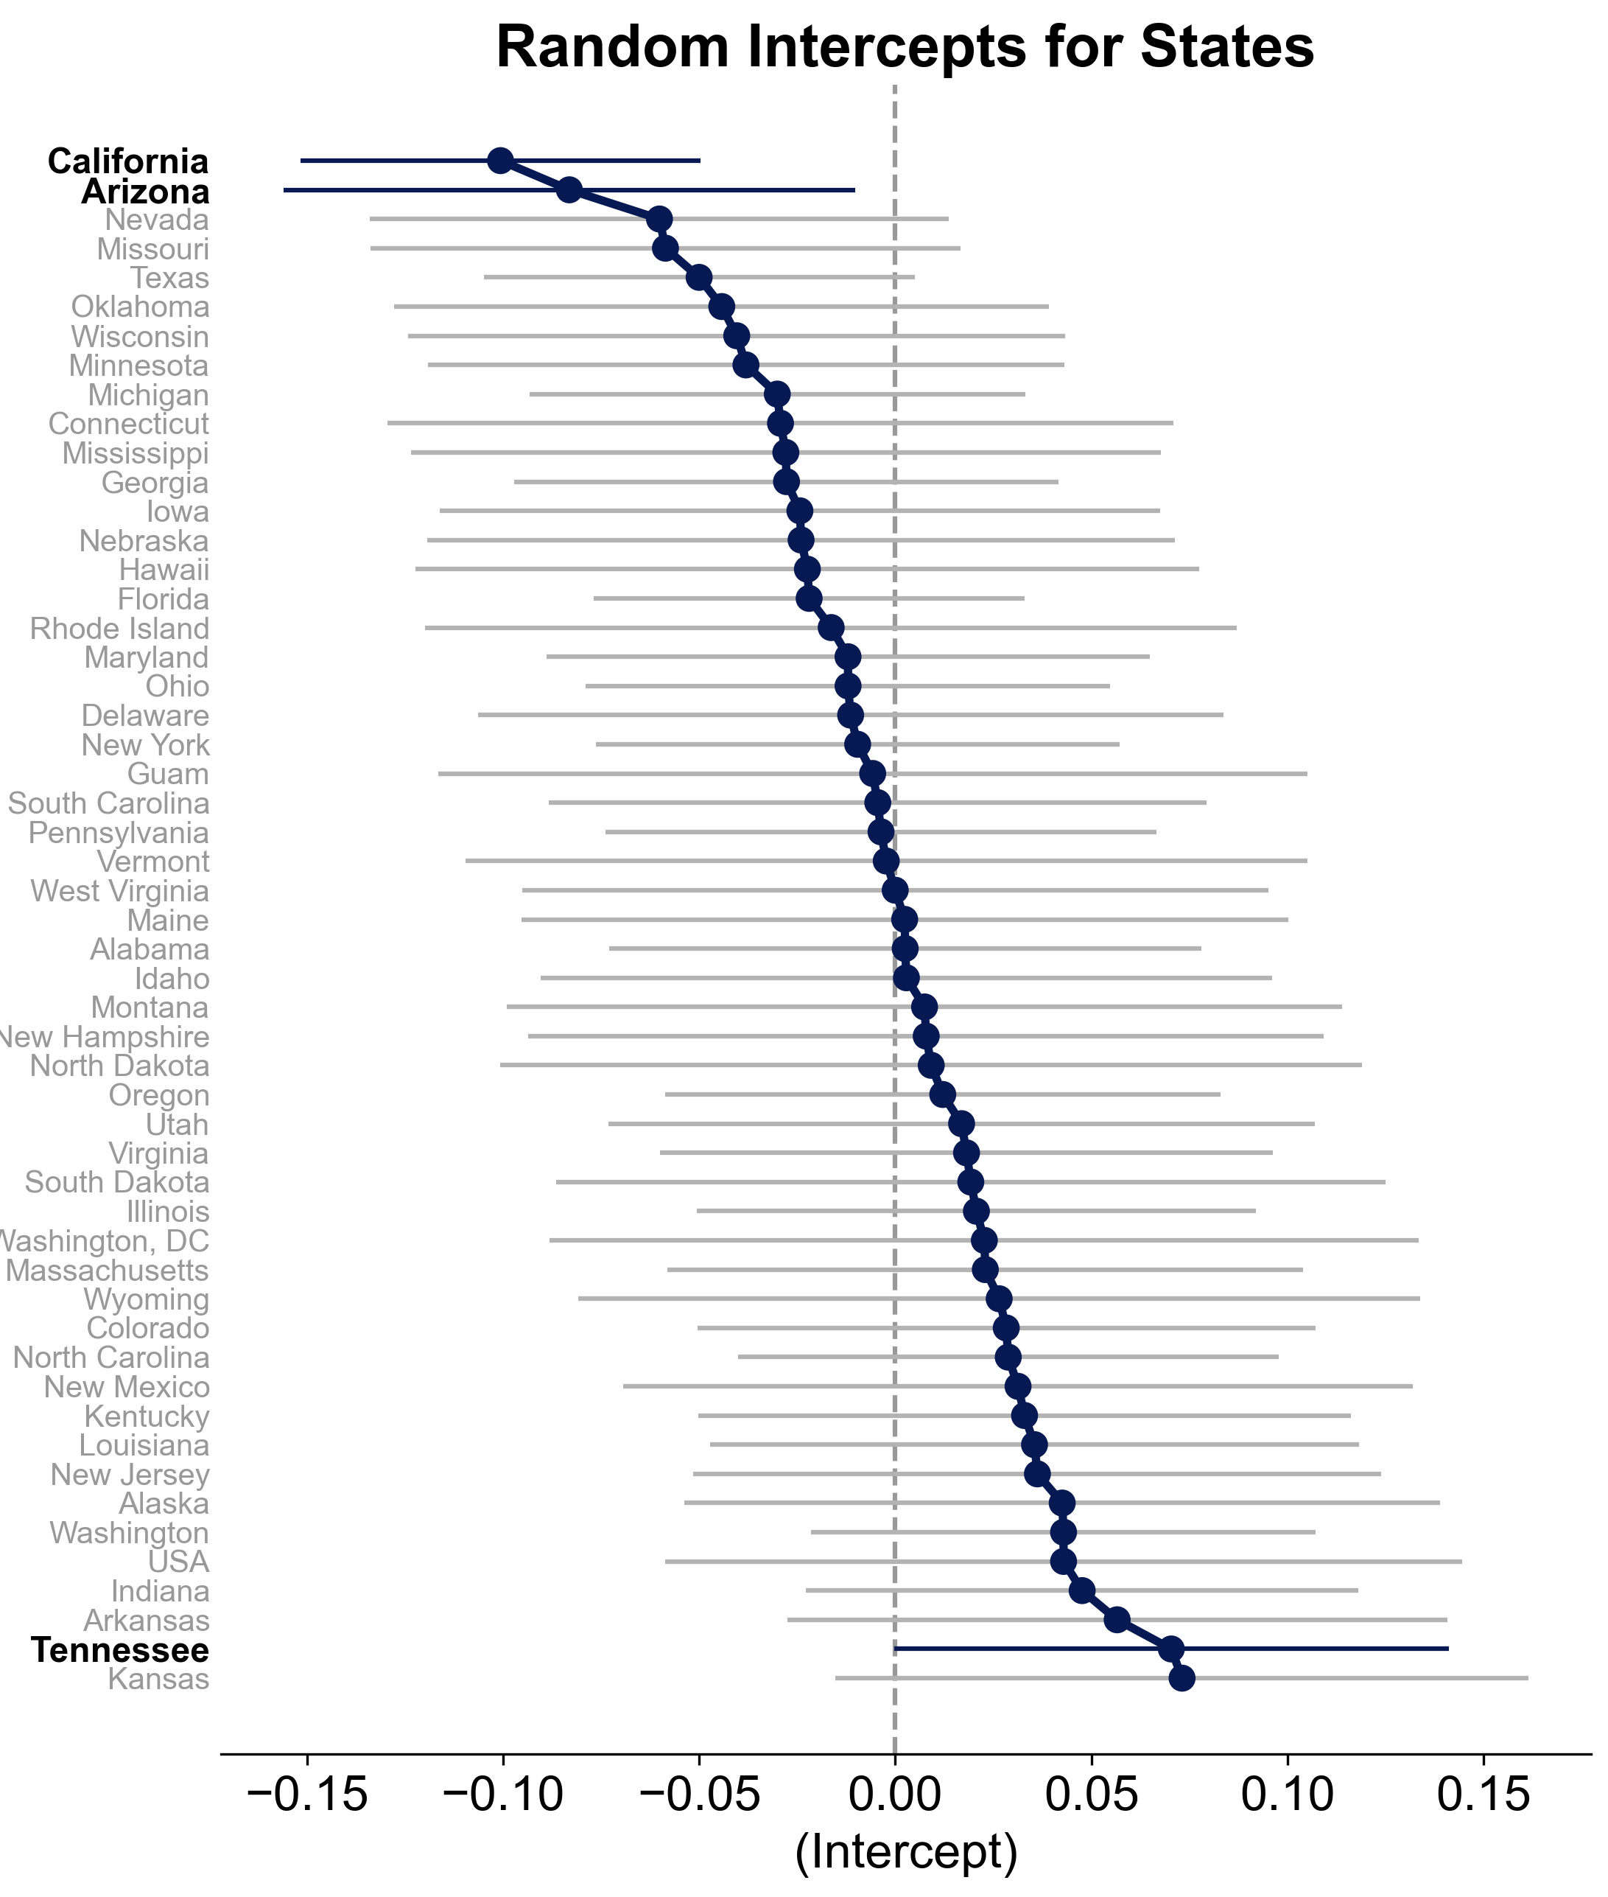
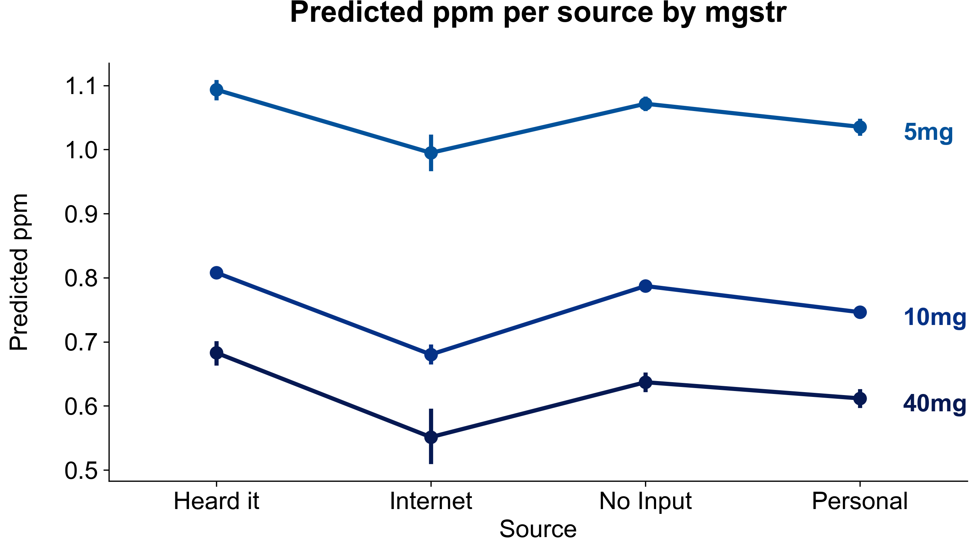
Interpretation
Fixed Effects
Random Effects: State Level
Notes:
Moritz

Slide 9
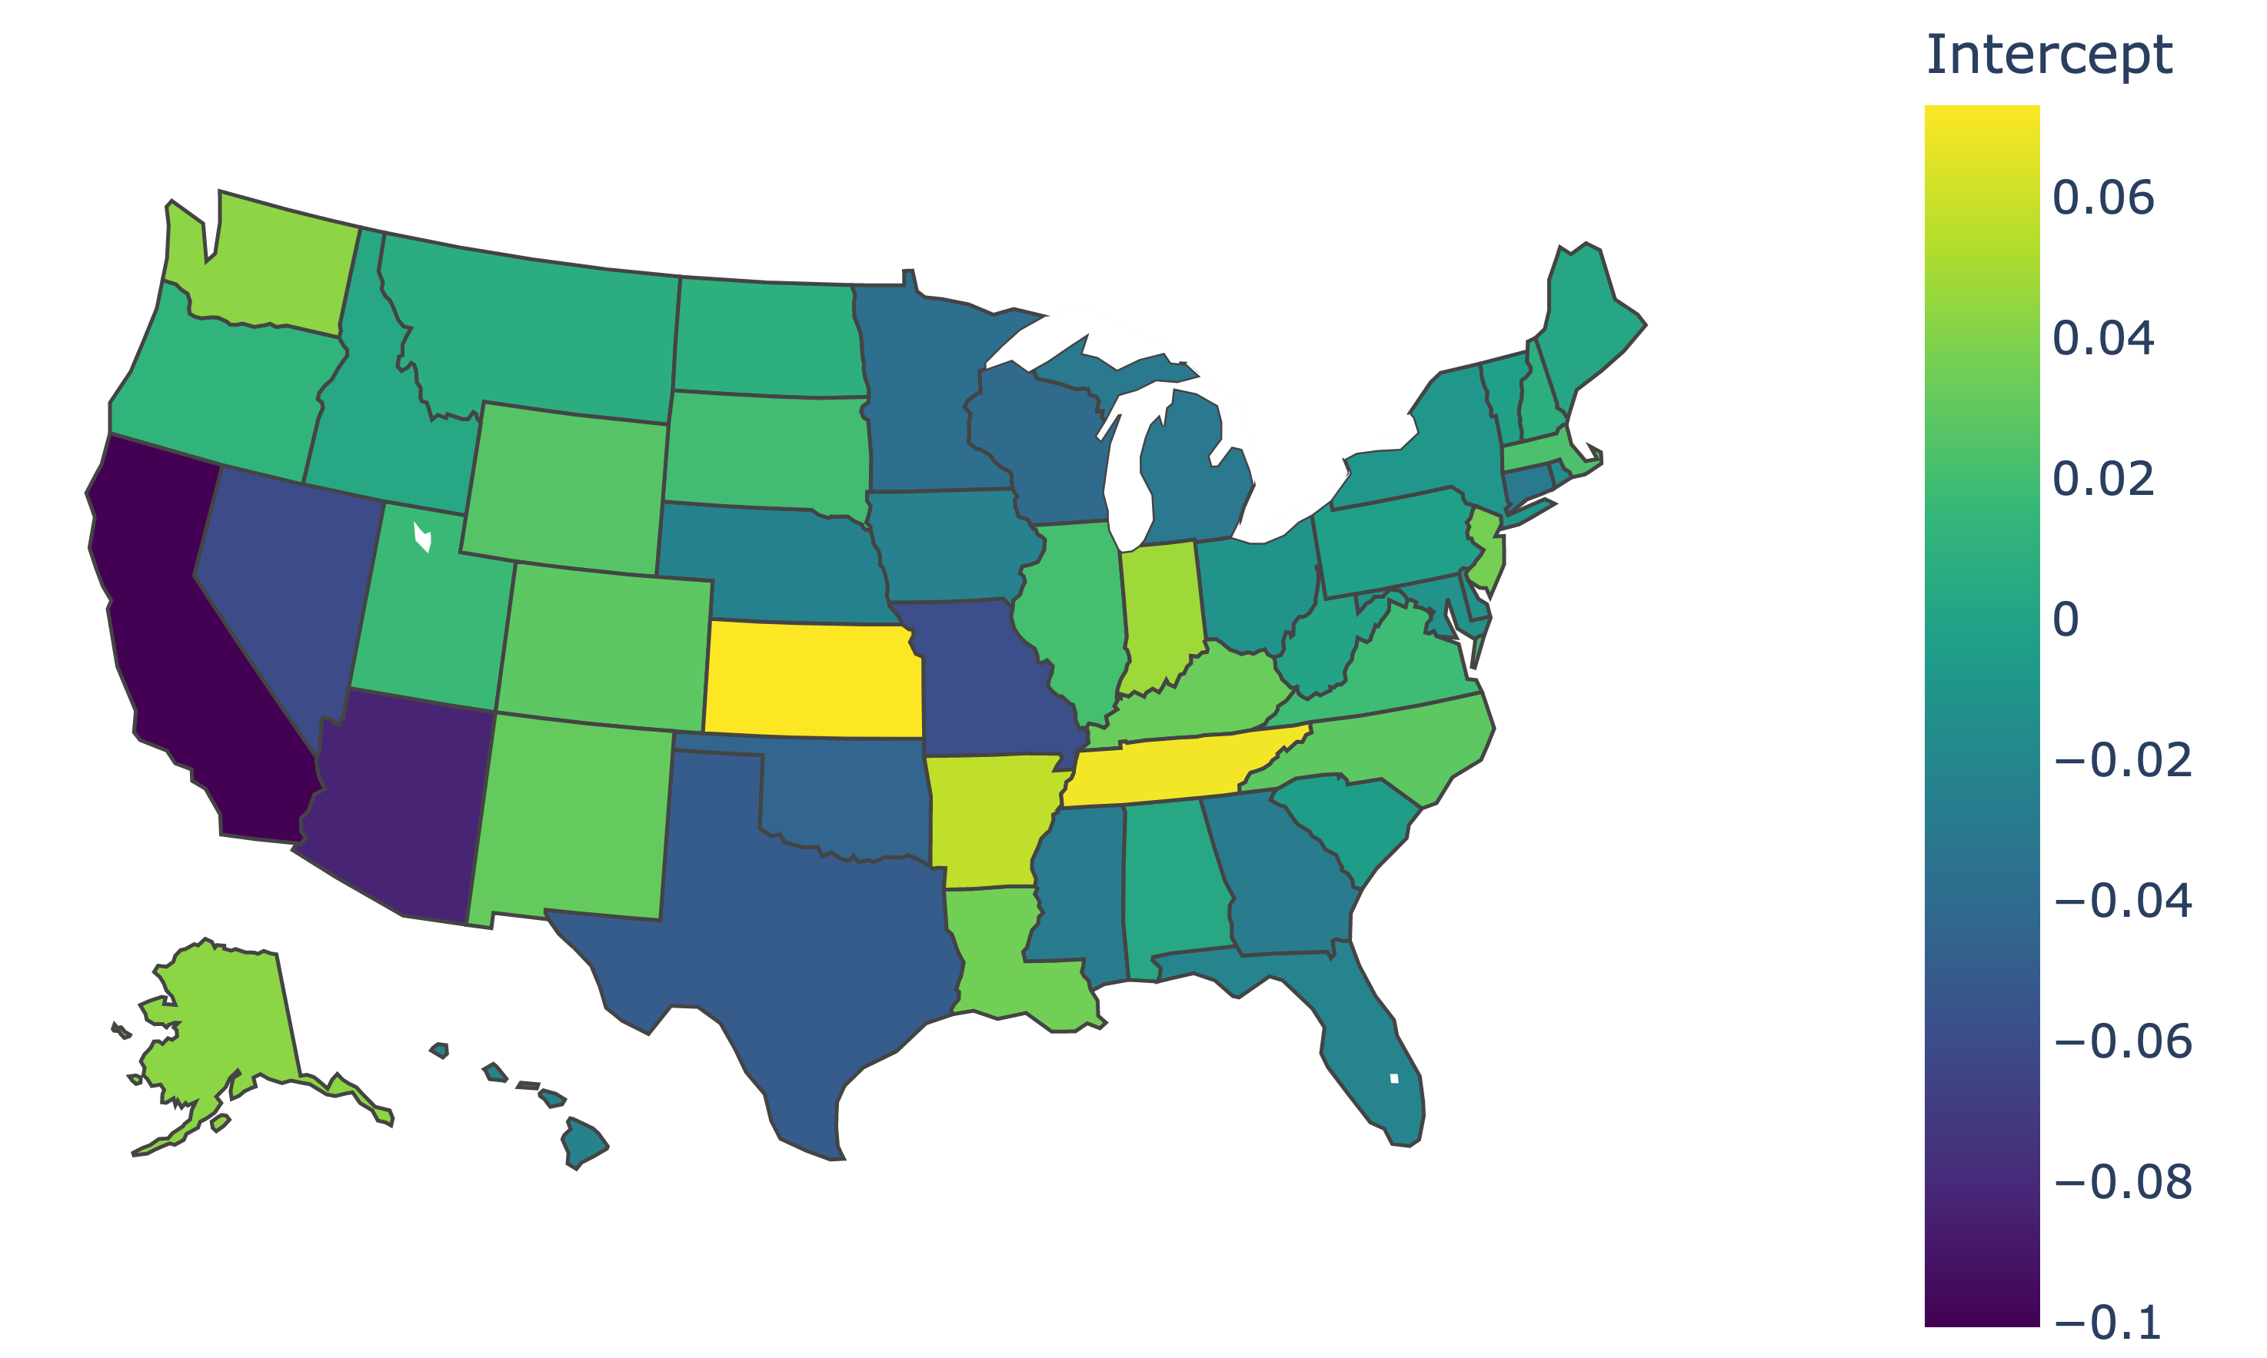
Geographical Visualization
Notes:
Moritz

Slide 10
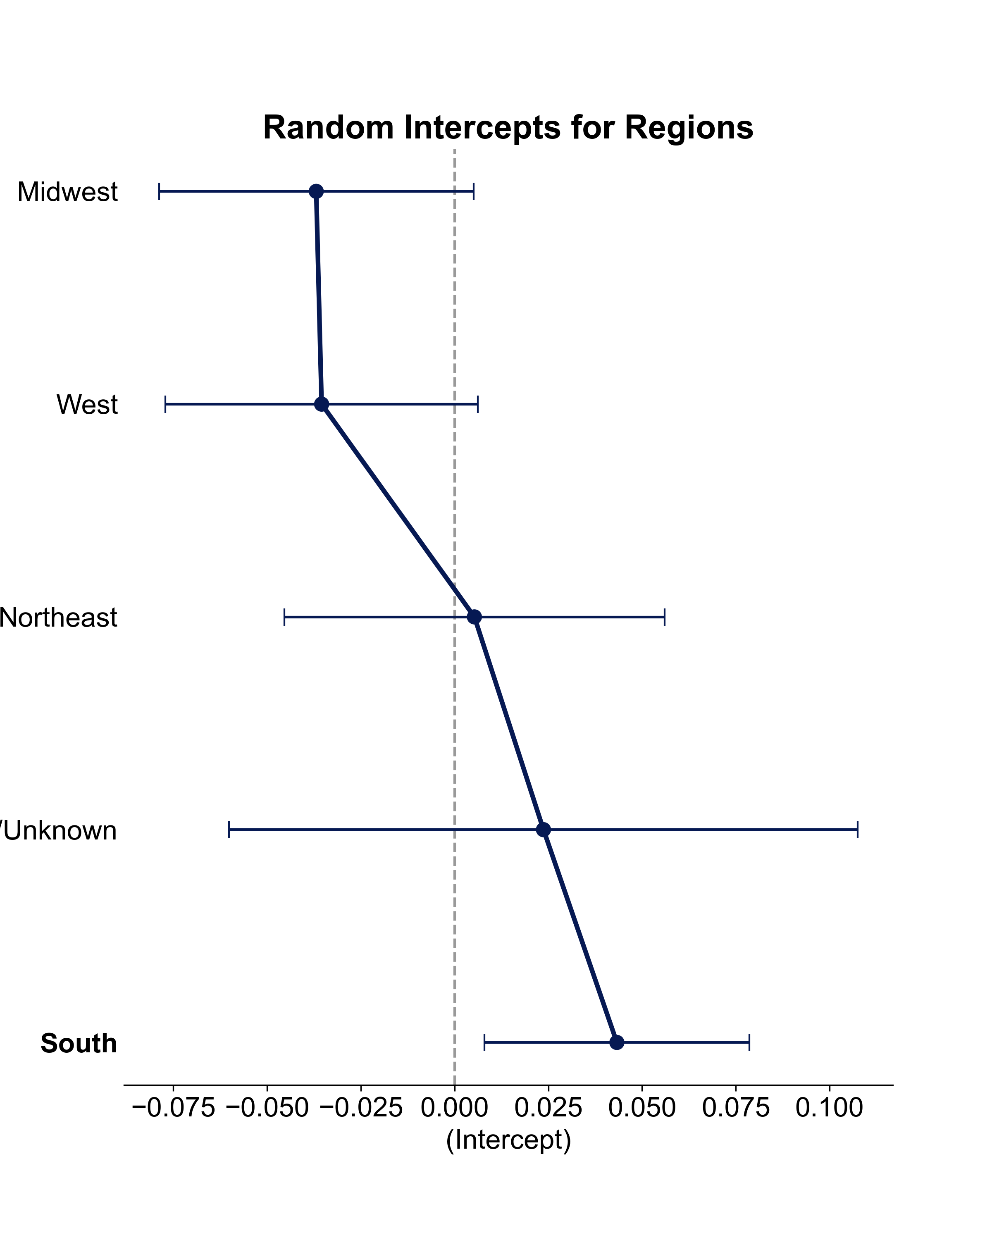

Interpretation
Random Effects: Region Level
Random Effects: Summary
Std.Dev.
Notes:
Moritz

Slide 11
Title
Subtitle
Notes:
Moritz

